Slide 1
6.3: Classification
Kamilah Ebrahim
The University of Toronto
6.3: Classification

Slide 2
Introduction
Classification involves predicating a qualitative response by assigning it to a category. The methods that are used to classify observations are called classifiers and most of them work by following two steps:
Compute the probability that an observation belongs to a category.
Classify the observation based on some probability threshold (i.e. if the probability that an observation belongs to some category is greater than 0.5 then assign the observation to that category)
6.3: Classification

Slide 3
Why not use linear regression?
Suppose we are trying to diagnose a patient with either a stroke, drug overdose, or epileptic seizure based on their symptoms. We can code this response as follows
1₂
if stroke;
if drug overdose;
𝑌 =
3
if epileptic seizure.
At this point we could use linear regression to predict 𝑌 based on a set of predictors. However
there are several problems with this coding Implies an ordering of the outcomes.
The difference between epileptic seizure and stroke versus stroke and drug overdose is assumed to be the same.
A different ordering would give completely different results for the linear regression. There is no convenient way to code a qualitative response with more than two levels so that linear regression can be used.
6.3: Classification

Slide 4
Why not use linear regression?
The 0/1 coding for a binary qualitative response variable does not suffer the same problems.
However the probabilities we obtain will be diﬀicult to interpret
negative probabilities probabilities above 1
So, linear regression only able to give crude estimates of the probabilities for a binary response. In summary, we don’t use linear regression for classification since:
It does not work for a qualitative response variable with more than 2 classes. With 2 classes, the probability estimates are not meaningful.
6.3: Classification

Slide 5
Logistic Regression
Logistic regression models the probability that the response 𝑌 belongs to a particular category. Suppose we have a qualitative response 𝑌 that has two levels, coded as 0 and 1, and one predictor variable. We want to model
𝑝(𝐸) = Pr(𝑌 = 1 ∣ 𝐸)
The logistic function keeps the probabilities between 0 and 1. For one predictor, the function is
𝑝(𝐸) = ^{𝑒𝛽0+𝛽1𝐸}
_{1 + 𝑒}𝛽₀+𝛽₁𝐸
As with linear regression, we are trying to fit 𝛽₀, 𝛽₁.
6.3: Classification

Slide 6
Estimating the regression coeﬀicients
𝛽₀ and 𝛽₁ are estimated using the training data using a method called maximum likelihood. This involves maximizing the likelihood function, but we will not cover the details of this function.
6.3: Classification

Slide 7
Odds
The odds compares the probability of a particular outcome to the probability of all the other outcomes.
𝑝(𝐸) _{= 𝑒𝛽0+𝛽1𝐸} 1 − 𝑝(𝐸)
takes values between (0, ∞)
odds close to 0 ⇒ very low probability of the outcome in question
odds much greater than 0 ⇒ very high probability of the outcome in question.
6.3: Classification

Slide 8
Log Odds
The log odds (or logit) is obtained by taking the logarithm of the odds
log ( ^{𝑝(𝐸)} ) = 𝛽₀ + 𝛽₁𝐸
1 − 𝑝(𝐸)
Increasing 𝐸 by one unit changes the log odds by 𝛽₁.
If 𝛽₁ is positive, increasing 𝐸 is associated with increasing 𝑝(𝐸)
If 𝛽₁ is negative, increasing 𝐸 is associated with decreasing 𝑝(𝐸)
6.3: Classification

Slide 9
Making Predictions
Once the coeﬀicients have been estimated predictions can be made for any value of the predictor. Logistic regression will give the probability of the outcome and the classification will be according to some threshold which depends on the problem or how conservative the predictions should be.
6.3: Classification

Slide 10
Multiple Predictors
Simple logistic regression can be extended to include multiple predictors
_{𝑝(𝐸) = 1 𝑒}𝛽₀+𝛽₁𝐸₁+⋯+𝛽_{𝑝}𝐸_{𝑝}
_{+ 𝑒}𝛽₀+𝛽₁𝐸₁+⋯+𝛽_{𝑝}𝐸_{𝑝}
The log odds in this case becomes
log ( ^{𝑝(𝐸)} ) = 𝛽₀ + 𝛽₁𝐸₁ + ⋯ + 𝛽_{𝑝}𝐸_{𝑝}
1 − 𝑝(𝐸)
As before, the maximum likelihood is used to estimate the coeﬀicients.
6.3: Classification

Slide 11
Exercise: Logistic Regression
Open the Classification Exercises R Markdown or Jupyter Notebook file.
Go over “Getting Started” together as a class.
Go through the “Logistic Regression” as a class.
5 minutes for students to complete the questions from “Logistic Regression”. Questions should be completed at home if time does not allow.
6.3: Classification

Slide 12
Multinomial logistic regression
We can extend to two-class logistic regression to accommodate 𝐾 classes. We need to select one class to serve as the baseline, so we will choose the 𝐾th class. Then the model becomes
1
Pr(𝑌 = 𝐾 ∣ 𝐸 = 𝑥) =
Pr(𝑌 = 𝑘 ∣ 𝐸 = 𝑥) =
and,
𝑛−1
𝛽 +𝛽 𝑥 +⋯+𝛽 𝑥
1 + ∑ 𝑒
𝑙0 𝑙1 1 𝑙𝑝 𝑝
𝑙=1
_{𝑒}𝛽_{ℎ0}+𝛽_{ℎ1}𝑥₁+⋯+𝛽_{ℎ𝑝}𝑥_{𝑝}
for 𝑘 = 1, … , 𝐾 − 1
𝑛−1
𝛽 +𝛽 𝑥 +⋯+𝛽 𝑥
1 + ∑ 𝑒
𝑙0 𝑙1 1 𝑙𝑝 𝑝
𝑙=1
The interpretation of the coeﬀicients is tied to the choice of the baseline.
6.3: Classification

Slide 13
Bayes Classifier
Suppose that we have a qualitative response variable 𝑌 with 𝐾 distinct and ordered classes. The Bayes classifier use a less direct approach using Bayes’ theorem to estimating the probabilities
_{𝑛}𝜋_{𝑘}𝑓_{𝑘}(𝑥)
Pr(𝑌 = 𝑘 ∣ 𝐸 = 𝑥) =
∑_{𝑙=1} 𝜋_{𝑙}𝑓_{𝑙}(𝑥)
𝜋_{𝑘} is the prior probability that a random observation belongs to the 𝑘th class.
estimated as the fraction of the training observation that belong to the 𝑘th class.
𝑓_{cl𝑘a}(_{s}𝐸_{s.}) ≡ Pr(𝐸 ∣ 𝑌 = 𝑘) is the density function of 𝐸 for an observation from the 𝑘th
There are several methods we will discuss that attempt to approximate the Bayes classifier using different approaches for estimating 𝑓_{𝑘}(𝑥).
6.3: Classification

Slide 14
Why Use Bayes Classifier?
When there is a lot of separation between two classes logistic regression does not does not provide stable coeﬀicient estimates.
If the distribution of each of the predictors is approximately normal and the sample size is small, these approaches are more accurate.
The methods that attempt to estimate the Bayes classifier that we will cover are: Linear discriminant analysis,
Quadratic discriminant analysis, and Naive Bayes.
6.3: Classification

Slide 15
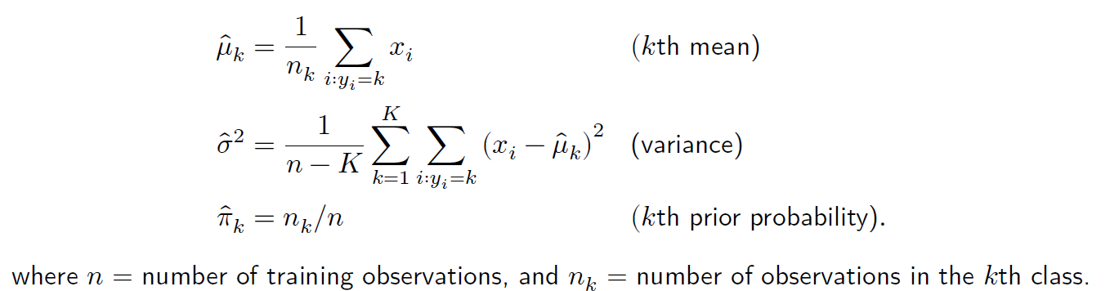
Linear Discriminant Analysis
Suppose we only have one predictor, so 𝑝 = 1. In order to estimate 𝑓_{𝑘}(𝑥) we make the
following assumptions:
𝑓_{𝑘}(𝑥) is normal
the variance is the same across all 𝐾 classes.
Linear discriminant analysis (LDA) then approximates the Bayes classifier using the estimates:
6.3: Classification

Slide 16
Linear Discriminant Analysis
The LDA classifier uses the estimates for 𝜋_{𝑘}, 𝜇_{𝑘}, and 𝜎² to assign an observation 𝐸 = 𝑥 to the class that has the largest
𝜇̂ 𝜇̂
2
̂
𝑘
𝑘
𝛿 (𝑥) = 𝑥 ⋅ − + log (𝜋̂ )
𝑘
𝜎̂ 2𝜎̂²
𝑘
2
6.3: Classification

Slide 17
Linear Discriminant Analysis for 𝑝 > 1
Now suppose we have 𝐸 = (𝐸₁, … , 𝐸_{𝑝}) predictors. Assumptions: 𝐸 is multivariate Gaussian
(i.e. each predictor is normally distributed with some correlation between them) class-specific mean vectors
common covariance matrix across classes.
We classify observations to the class for which 𝛿_{𝑘}̂ (𝑥) is the largest.
6.3: Classification

Slide 18
Binary Classifiers
Binary classifiers, similarly to such as tests for diseases (positive versus negative), can make two types of errors:
Incorrectly assign an individual as positive when they are negative (False positive). Incorrectly assign an individual as negative when they are positive (False negative).
6.3: Classification

Slide 19
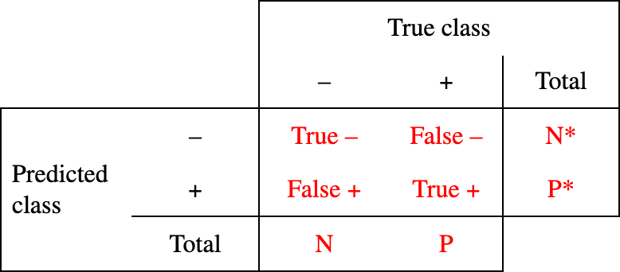
Confusion Matrix
A confusion matrix helps to summarize the two types of errors of binary classifiers. They compare the LDA predictions to the true outcomes of the training observations. In the case of medical tests this looks like:
N and P are the number of actual negatives and positives respectively in the training data. N* and P* are the number of predicted negative and positives in the training data.
The red text is where the numbers are filled in.
6.3: Classification

Slide 20
Threshold
Recall that the Bayes classifier assigns observations to the class for with the posterior probability is the greatest. Since probabilities sum to 1, for a binary classifier this means that a test will come back positive if:
Pr(positive ∣ 𝐸 = 𝑥) > 0.5
That is, the binary classifier uses a threshold of 50%. Depending on the classification problem, one may want to specify a different threshold level. For example:
positive if Pr(positive ∣ 𝐸 = 𝑥) > 0.2
6.3: Classification

Slide 21
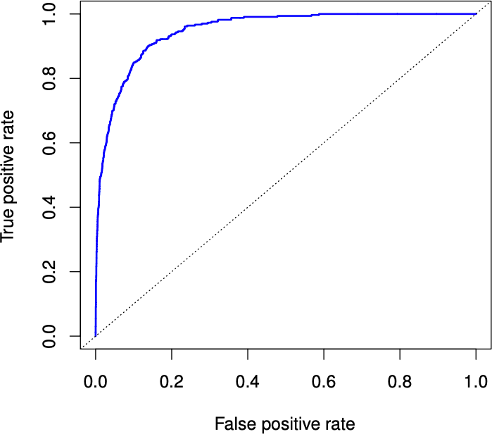
The ROC (receiver operator characteristics) curve is a method for visualising the errors previously discusses for all possible thresholds.
ROC
Performance of a classifier is given by the area under the ROC curve, called the AUC.
The larger the AUC the better.
Ideal ROC curve is as close to the top left corner as possible.
6.3: Classification

Slide 22
Exercise: Linear Discriminant Analysis
Open the Classification Exercises R Markdown or Jupyter Notebook file.
Go over the “Linear Discriminant Analysis” section together as a class.
5 minutes for students to complete the questions from “Linear Discriminant Analysis”. Questions should be completed at home if time does not allow.
6.3: Classification

Slide 23
Quadratic Discriminant Analysis
The Quadratic discriminant analysis (QDA) classifier assumes that: observations are drawn from a class-specific Gaussian distribution each class has its own covariance matrix (unlike LDA)
The QDA uses estimates for the class-specific means (𝜇_{𝑘}), covariance matrices (Σ_{𝑘}), and prior probability (𝜇_{𝑘}) to assign an observation 𝑥 to the class for which
𝛿_{𝑘}(𝑥) = − ¹ (𝑥 − 𝜇_{𝑘})^{𝑇} Σ_{𝑘}⁻¹ (𝑥 − 𝜇_{𝑘}) − ¹ log |Σ_{𝑘}| + log 𝜋_{𝑘}
2 2
is the largest. Unlike the LDA, the function for 𝛿_{𝑘}(𝑥) is quadratic which gives the QDA it’s name.
6.3: Classification

Slide 24
LDA vs QDA
When to use the LDA versus the QDA:
LDA is better than QDA when there are few training observations since it requires fewer parameters to be estimated.
QDA is best when there are many training observations or when the assumption of a common covariance matrix in the LDA is clearly wrong.
6.3: Classification

Slide 25
Exercise: Quadratic Discriminant Analysis
Open the Classification Exercises R Markdown or Jupyter Notebook file.
Go over the “Quadratic Discriminant Analysis” section together as a class.
5 minutes for students to complete the questions from “Quadratic Discriminant Analysis”. Questions should be completed at home if time does not allow.
6.3: Classification

Slide 26
Naive Bayes
The naive Bayes classifier assumes: within each class, the 𝑝 predictors are independent. This allows us to disregard any association between the 𝑝 predictors and gives the form of 𝑓_{𝑘}(𝑥) as
𝑓_{𝑘}(𝑥) = 𝑓_{𝑘1} (𝑥₁) × 𝑓_{𝑘2} (𝑥₂) × ⋯ × 𝑓_{𝑘𝑝} (𝑥_{𝑝})
where 𝑓_{𝑘𝑗} is the density function of the 𝑗th predictor for observations in the 𝑘th class. To estimate 𝑓_{𝑘𝑗} using the training data there are several options:
For quantitative 𝐸_{𝑗}:
assume that for each class, the 𝑗th predictor is drawn from a normal distribution, or
estimate it as the fraction of the training observations in the 𝑘th class that belong to the
same histogram bin as 𝑥_{𝑗}.
For quantitative 𝐸_{𝑗}:
count the proportion of training observations for the 𝑗th predictor that belong to each class.
6.3: Classification

Slide 27
Exercise: Naive Bayes
Open the Classification Exercises R Markdown or Jupyter Notebook file.
Go over the “Naive Bayes” section together as a class.
5 minutes for students to complete the questions from “Naive Bayes”. Questions should be completed at home if time does not allow.
6.3: Classification

Slide 28
𝐾-Nearest Neighbours
The 𝐾-nearest neighbors (KNN) classifier works very differently than any of the previous classification methods. For a test observation 𝑥₀, it identifies 𝐾 training data points that are closest to 𝑥₀ (represented by 𝒩₀) and estimates the conditional probability for class 𝑗 as
Pr (𝑌 = 𝑗 ∣ 𝐸 = 𝑥₀) = ¹ ∑ 𝐼 (𝑦_{𝑖} = 𝑗)
^{𝐾} 𝑖∈𝒩₀
where 𝐼(𝑦_{𝑖} = 𝑗) if an indicator variable that equals 1 is 𝑦_{𝑖} = 𝑗 and 0 otherwise. The KNN classifier classifies the test observation 𝑥₀ to the class for which the above probability is the largest.
6.3: Classification

Slide 29
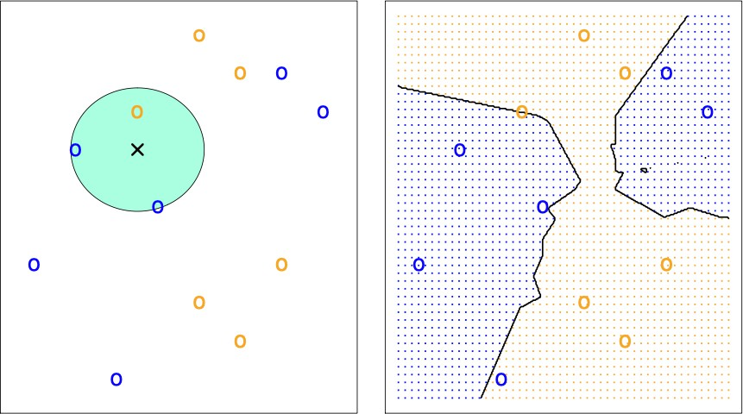
𝐾-Nearest Neighbours
These figures illustrate the KNN approach with 𝐾 = 3. To the left we see the 3 closest points to x are 1 orange and 2 blue so this observation will be classified as blue. The right figure shows the decision boundaries where an observation will be classified as blue or orange.
6.3: Classification

Slide 30
Exercise: K-Nearest Neighbours
Open the Classification Exercises R Markdown or Jupyter Notebook file.
Go over the “K-Nearest Neighbours” section together as a class.
5 minutes for students to complete the questions from “K-Nearest Neighbours”. Questions should be completed at home if time does not allow.
6.3: Classification

Slide 31
How to choose the classification method
The choice of classification method depends on two things:
the true distribution of the predictors in each of the 𝐾classes, and
the number of training observations (𝑛) compared to to the number of predictors (𝑝).
6.3: Classification

Slide 32
References
Chapter 4 and section 2.2.3 of the ISLR2 and ISLP books:
James, Gareth, et al. “Classification.” An Introduction to Statistical Learning: with Applications in R, 2nd ed., Springer, 2021.
James, Gareth, et al. “Classification.” An Introduction to Statistical Learning: with Applications in Python, Springer, 2023.
6.3: Classification

